Slide 1
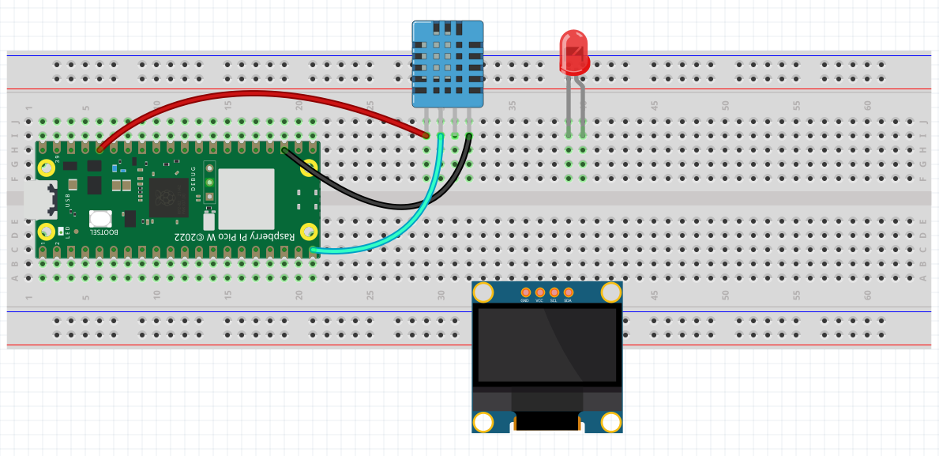
DHT11
GP14
GP15
SSD1306
SCL – GP17
SDA – GP16

